Slide 1
Dealing with Multiple Asynchronous Operations

Slide 2
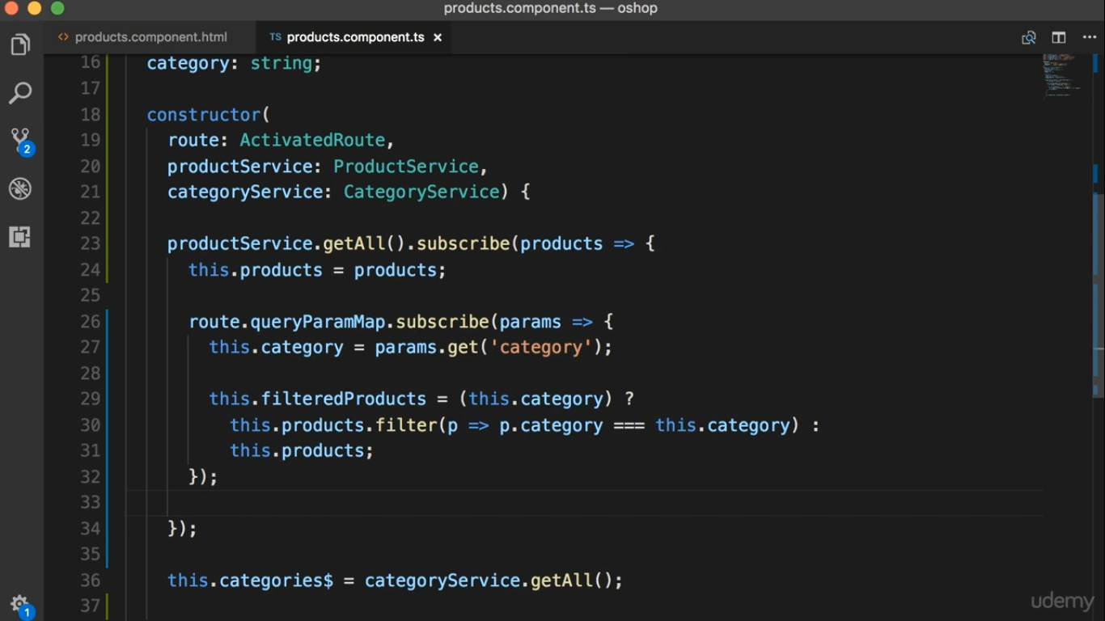

Slide 3
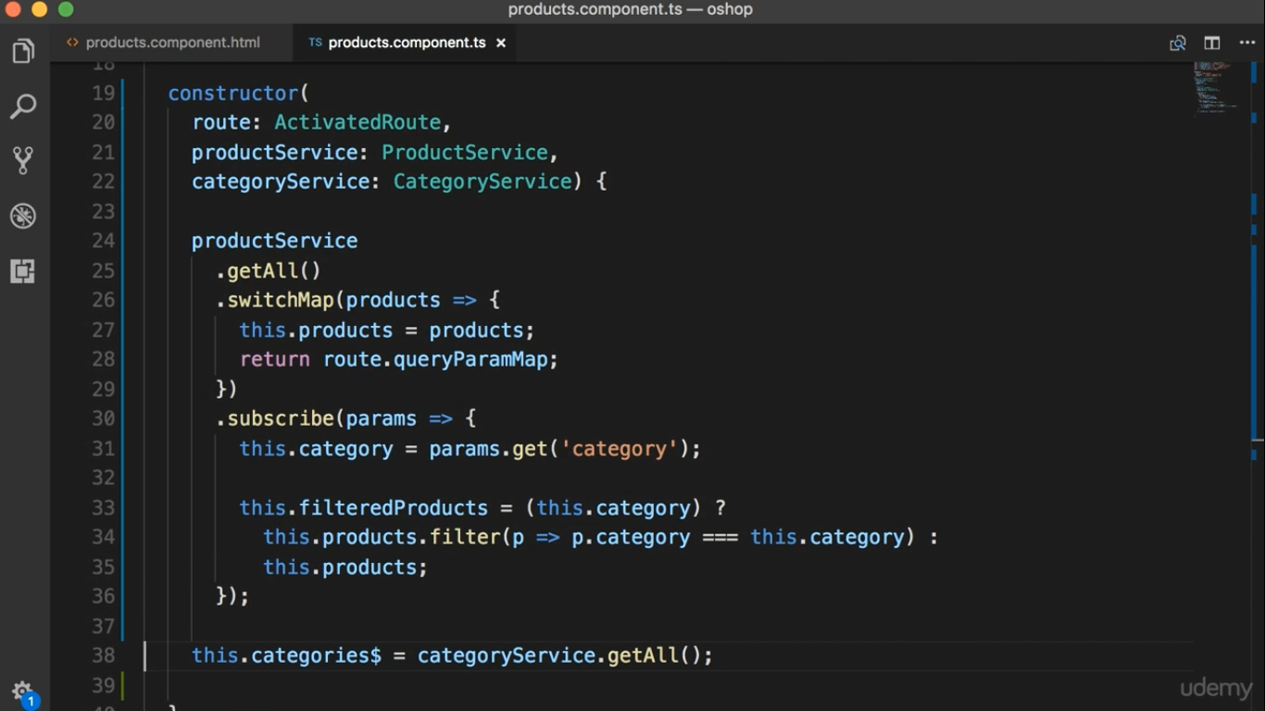

Slide 4
